Slide 1

Global Warming
Global Climate Change

Slide 2
Introduction
Is the world getting warmer?
If so, are the actions of mankind to blame for earth’s temperature increases?
What can/should be done about these issues?
Notes:
In examining global warming, we will be looking at questions such as 
Is the world getting warmer? 
If so, are the actions of mankind to blame for earth’s temperature increases? 
What can or should be done about global warming? 
Are the potential resolutions to global warming worth the cost to implement them? 

Slide 3
Definition:
A slow, long term rise in the average world temperature caused by the emission of greenhouse gases produced by burning fossil fuels and natural gases. (Joshua.p.377)

Slide 4
Greenhouse gases
Water vapors 30-70%
Carbon dioxide 9-26%
Methane 4-9%
Ozone 3-7%
Chlorofluorocarbons
Nitrous oxide
Notes:
This is a big picture examination of the earth’s climate 
The Earth was formed around 4.6 billion years ago 
And was originally very hot 
However, the Sun’s energy output was only 70% of what it is presently 
Liquid water was present on the surface around 4.3 billion years ago

Slide 5
Causes of Global warming
Carbon dioxide
Deforestation
Burning of fossil fuels
Absorbing of sun’s radiation
Transportation
Industrial process
Freakish weather
Industrial countries-80%
US and China-40%
Notes:
This is a big picture examination of the earth’s climate 
The Earth was formed around 4.6 billion years ago 
And was originally very hot 
However, the Sun’s energy output was only 70% of what it is presently 
Liquid water was present on the surface around 4.3 billion years ago

Slide 6
Impacts
Melting of polar ice
Rising of sea level
Flooding coastal areas
Altering weather patterns
Draughts
Disruption in ecosystem
Benefits some and make agriculture productive
Notes:
This is a big picture examination of the earth’s climate 
The Earth was formed around 4.6 billion years ago 
And was originally very hot 
However, the Sun’s energy output was only 70% of what it is presently 
Liquid water was present on the surface around 4.3 billion years ago

Slide 7
Impacts
Ice melting creating new shipping routes
Arctic seas hold large deposits of oil and gas, accessible as ice melts
Changing in the patterns of rain fall
Cyclones around the globe
Expansion of sub-tropical deserts
Polar bear go extinct
Notes:
This is a big picture examination of the earth’s climate 
The Earth was formed around 4.6 billion years ago 
And was originally very hot 
However, the Sun’s energy output was only 70% of what it is presently 
Liquid water was present on the surface around 4.3 billion years ago

Slide 8
UN Environment Program (UNEP)
A program that monitors environmental conditions and among other activities, works with the World Meteorological Organization to measure changing in global climate (Joshua.p.378)

Slide 9
Intergovernmental Panel on Climate Change

Slide 10
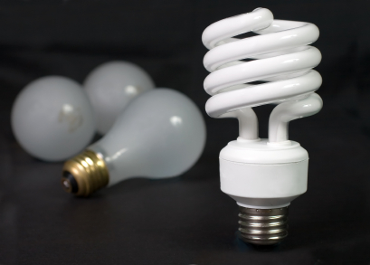
We can make some simple substitutions
Replacing just 1 incandescent light bulb with 1 compact florescent bulb saves about 150 pounds of carbon dioxide per year!
If every American household replaced just 5 high-use incandescent bulbs with compact florescent lights we'd collectively save more than $8 billion each year in energy costs and we would prevent the greenhouse gases equivalent to the emissions from nearly 10 million cars.
Source: http://www.energystar.gov

Slide 11
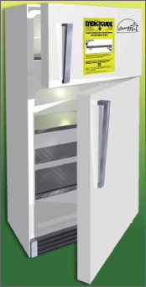
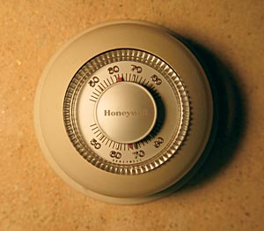

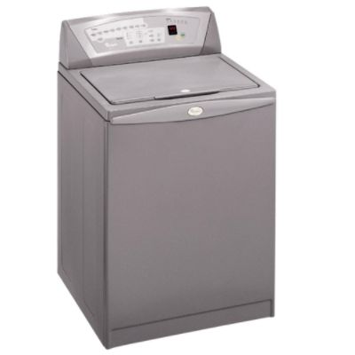
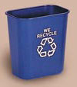

Small changes really add up
Replace your old refrigerator with a new Energy Star:
Annual savings:
$90; 700 pounds CO₂
Set your thermostat down a few degrees in the winter
Annual savings:
$135; 1400 pounds CO₂
Drive JUST 10 fewer miles per week
Annual savings:
$80; 520 pounds CO₂
Wash clothes in cold water only
Annual savings:
$70; 500 pounds CO₂
Reduce your garbage by 10% through greater recycling or reduced packaging
Annual savings:
1200 pounds CO₂
Caulk and weather-strip around doors and windows
Annual savings:
$80; 650 pounds CO₂
* These are mid-range estimates from published sources; your savings may vary.

Slide 12
Blowing Up Your World
1. How many of you leave your bedroom light on when you are not in the room?
Turning off lights saves energy and money. The more energy used, the more rivers are dammed or more fossil fuel is burned, causing air pollution and increased levels of carbon dioxide in the atmosphere. 2 pts d

Slide 13
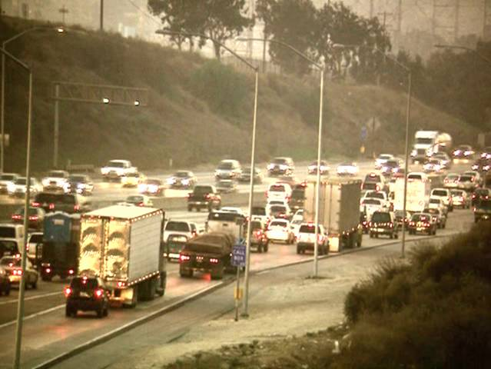
Blowing Up Your World
How many of you walked, bicycled or took public transportation to get to school today, instead of coming by private automobile?
Our reliance on cars that burn fossil fuels is one of the major causes of increased levels of carbon dioxide in the atmosphere and it is the primary cause of urban smog. 3 pts u

Slide 14
Blowing Up Your World
How many of you, when you drink a soft drink, throw the container into the garbage?
Throwing away containers of any kind wastes energy and resources and adds to our waste problem. Many towns are running out of landfill space. 3 pts d

Slide 15
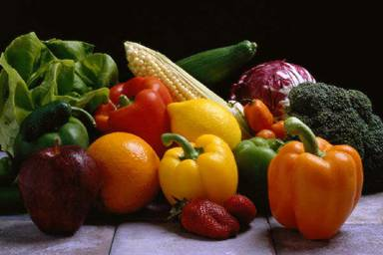
Blowing Up Your World
Blowing Up Your World
How many of you eat fresh vegetables instead of canned or frozen?
Fresh vegetables cook more quickly and are usually more nutritious than frozen or canned foods. Canned and frozen vegetables are often over-processed, contain additives, contribute to air pollution (transport and packaging) and add to our waste problem. 4 pts u

Slide 16
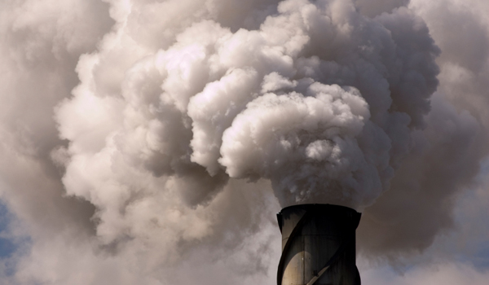
Blowing Up Your World
How many of you use a hairdryer or other energy-consuming convenience appliance, especially in the morning?
Hairdryers use a lot of energy. In the morning so much energy demand is put on our grids that power companies have to find other sources of energy just to meet the morning rush hour 2 pts d

Slide 17
Blowing Up Your World
. How many of you, when you go to a store, get a bag for your purchases, even if you have only one or two small items to carry?
Making paper and plastic bags uses energy and resources. The bags add to our litter and waste problems, and plastic is not biodegradable. Recycling is not the best answer because collecting and recycling materials requires energy. Instead, carry a reusable cloth bag or a knapsack with you. 3 pts d

Slide 18

Blowing Up Your World
How many of you carry your lunch to school in a lunch box or reusable container?
Making paper and plastic bags uses energy and resources. 3 pts u

Slide 19
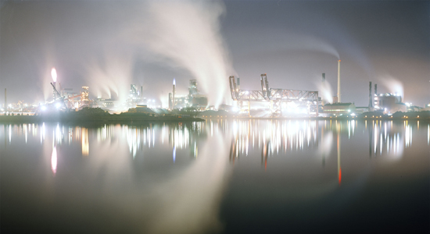
Blowing Up Your World
How many of you eat take-out or cafeteria food that is served in foam or plastic containers?
Polystyrene and other plastic containers are made from precious petrochemicals, do not decompose in landfills, and release toxic gases when they are burned in incinerators.
10 pts d

Slide 20
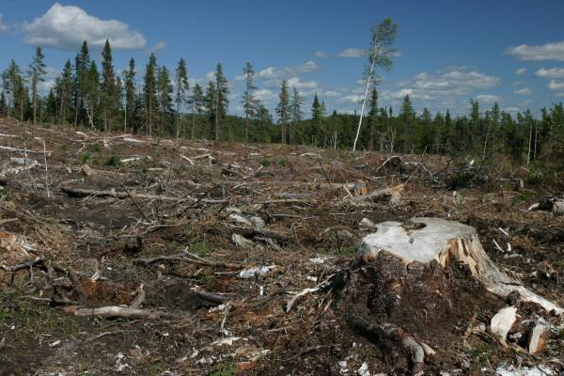
Blowing Up Your World
How many of you use handkerchiefs instead of tissues and use cloth towels instead of paper towels?
Paper comes from trees. The more of it we use, the more trees that are cut down 2 pts d

Slide 21
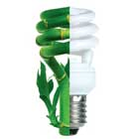
Blowing Up Your World
How many are changing incandescent bulbs for new compact fluorescent bulbs?
Changing one bulb could save 150 pounds of carbon dioxide per year!
10 pts u

Slide 22

Our take-home message…
Each of us must take steps to protect our Earth's climate.

